Slide 1
Predicting Loan defaults using logistic regression
Sonja Tilly
November 17

Slide 2
Project
Task: predict loan defaults
Build and test a logistic regression model.
Use 70% of the data to build the model and then test the model using the remaining 30%.
Notes:
The data contains rows of customers, with each column showing the features for loan applications that have been approved, together with outcomes of the loans (in the final column). The outcomes show that each customer has either defaulted or completed their loan.

Slide 3
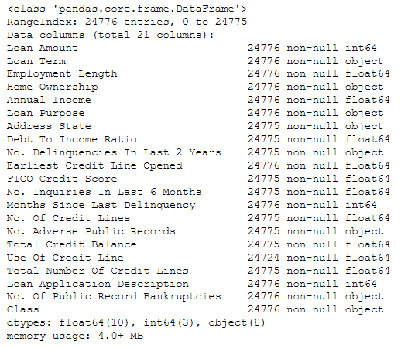
Project
Lending Club data
The data contains rows of customers, with each column showing the features for loan applications that have been approved, together with outcomes of the loans (in the final column ‘Class’).
The outcomes show that each customer has either defaulted or completed their loan.

Slide 4
Approach and method
Data exploration
Feature engineering
Classification
Results
Conclusion

Slide 5
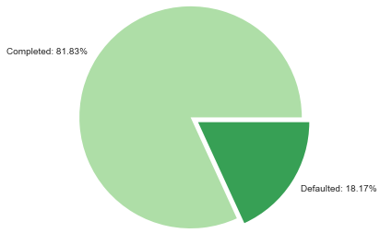
1) Data exploration
The dataset is unbalanced, with defaulted loans only accounting for 18.17%.
The unbalanced nature of the data will have to be considered when making predictions.

Slide 6
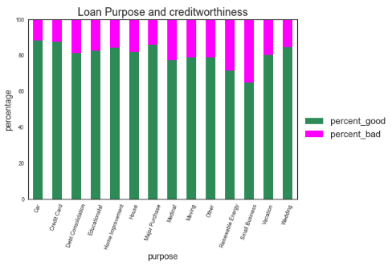
1) Data exploration

Slide 7
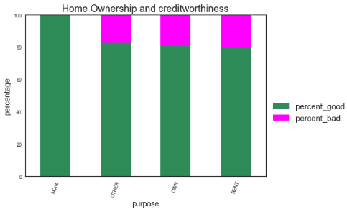
1) Data exploration

Slide 8
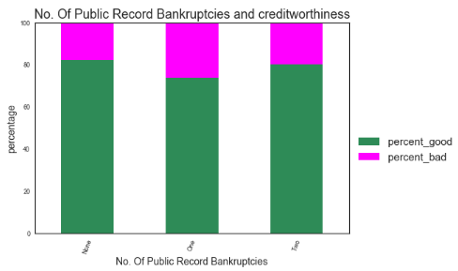
1) Data exploration

Slide 9
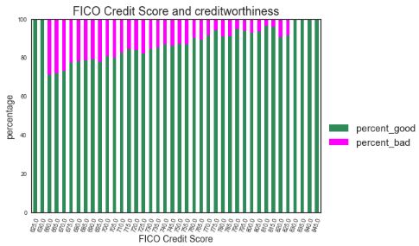
1) Data exploration

Slide 10
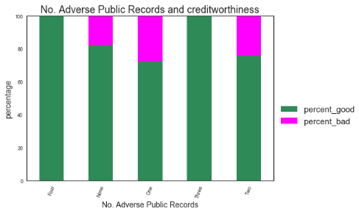
1) Data exploration

Slide 11
1) Data exploration
Add in map with % of defaulted loans

Slide 12
Feature engineering
convert 'Class' feature (=target) into numerical values
Assign ‘0’ to ‘creditworthy’
Assign ‘1’ to ‘uncreditworthy’

Slide 13
Feature engineering
summarise address states into geographic regions:
East_Coast 7731
South 6885
West_Coast 4485
Middle 3461
North 2213
summarise FICO scores into categories
Very Good 15950
Exceptional 5208
Good 3337

Slide 14
Feature engineering
create dummy variables for categorical data
'Loan Term',
'Home Ownership',
'Loan Purpose',
'FICO Credit Score',
'Address State'

Slide 15
Feature engineering
encode remaining columns containing object data types
'No. Delinquencies In Last 2 Years‘
'No. Adverse Public Records‘
'No. Of Public Records
These columns contain strings (e.g. one, two, three, …) describing numbers from 0 to 9
Change strings into numerical format

Slide 16
Feature engineering
drop redundant feature
Drop ‘Class’ feature
deal with nan values
Replace ‘nan’ with median values for each feature

Slide 17
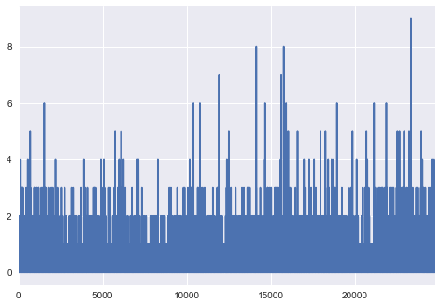
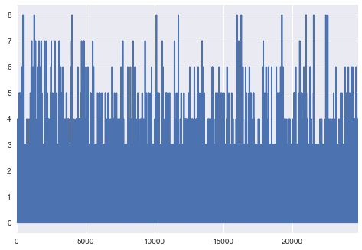
Feature engineering
Deal with outliers
No. Delinquencies In Last 2 Years:
Take out values above 4
No. Inquiries In Last 6 Months:
Take out values above 7

Slide 18
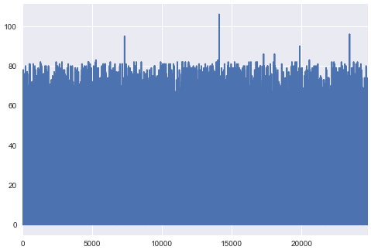
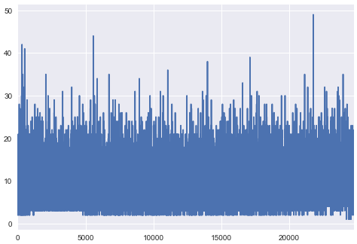
Feature engineering
Months Since Last Delinquency:
Take out values above 85
No. Of Credit Lines:
Take out values above 30

Slide 19
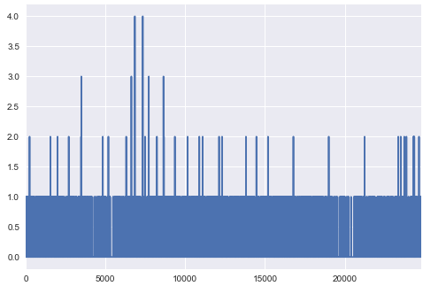
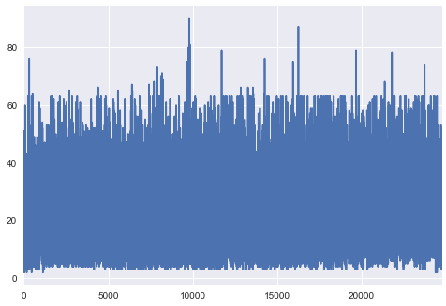
Feature engineering
No. Adverse Public Records:
Take out values above 1
Total Number Of Credit Lines:
Take out values above 65

Slide 20
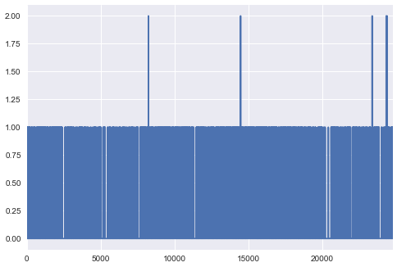
Feature engineering
No. Of Public Record Bankruptcies:
Take out values above 1

Slide 21
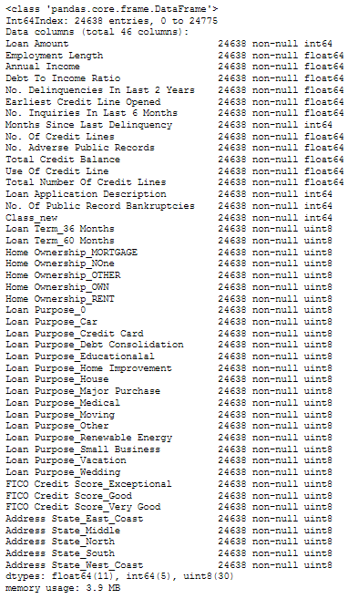
Feature engineering
The dataset has been reduced to 24638 entries from 24776

Slide 22
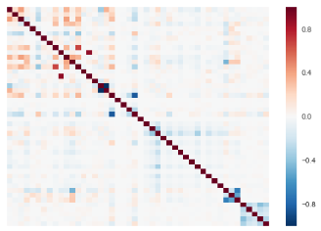
Feature engineering
Correlation matrix

Slide 23
Classification
Define predictor variables (X) and target variable (y)
X = transformed features excluding y
y = ‘0’ for completed and ‘1’ for defaulted loan
Implement train test split
Stratify target y as data may not be normally distributed

Slide 24
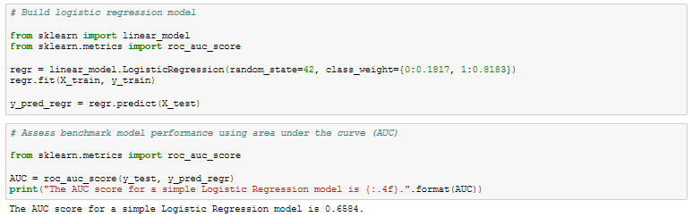
Classification
Build logistic regression model

Slide 25
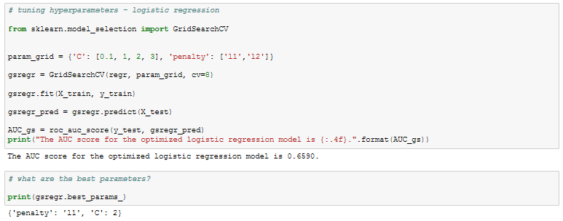
Classification
Optimise logistic regression model

Slide 26
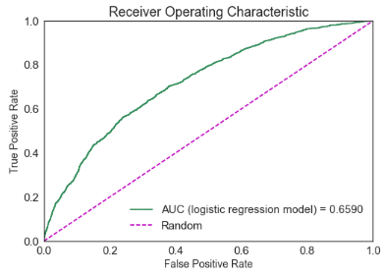
Results
AUC (‘area under the curve’) score
A receiver operating characteristic curve or ROC curve is a graph plotting the true positive rate against the false positive rate at different thresholds. It indicates how well a classifier can discriminate positive and negative instances and identify the best threshold for discriminating them.
The curve is created by plotting the true positive rate (TPR) against the false positive rate (FPR) at various threshold settings.
TPR (also called Recall or Sensitivity) = sum total positives/sum of condition positive
FPR (also called Fall-out) = sum of false positives/sum of condition negative
The area under the curve (AUC) is equal to the probability that a classifier will rank a randomly chosen positive instance higher than a randomly chosen negative one
From www.wikipedia.com
Notes:
The dataset is unbalanced, with bad loans accounting for only a small portion of the total number of loans. Due to this class imbalance, model accuracy will be assessed the Area Under the Curve (AUC).
A receiver operating characteristic curve or ROC curve is a graph plotting the true positive rate against the false positive rate at different thresholds. It indicates how well a classifier can discriminate positive and negative instances and identify the best threshold for discriminating them. The curve is created by plotting the true positive rate (TPR) against the false positive rate (FPR) at various threshold settings.
TPR (also called Recall or Sensitivity) = sum total positives/sum of condition positive
FPR (also called Fall-out) = sum of false positives/sum of condition negative
The area under the curve (AUC) is equal to the probability that a classifier will rank a randomly chosen positive instance higher than a randomly chosen negative one.

Slide 27
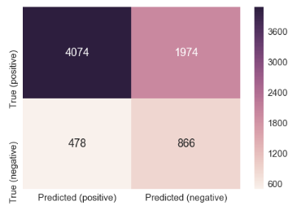
Results
Confusion matrix
fsfs
Notes:
What is a confusion matrix?
Visualization of the performance of an algorithm
Each row of the matrix represents the instances in a actual class while each column represents the instances in an predicted class

Slide 28
Conclusion
How does this add value for the client?
Limitations
Recommendations

Slide 29
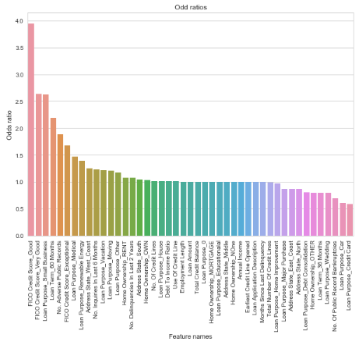
Appendix
Odd ratios
A score over 1 indicates a positive relationship with the target variable, a score below 1 a negative one.
Odds of success = ratio of probability of success / probability of failure
If the probability of success is 50/50, the odds of success are 1/1 = 1
For example, FICO Credit Score_Good has an odd ratio of 3.948234. This means than the odds for a defaulted loan are 295% higher than the odds for completed one.

